Slide 1
UCLA - Evaluation Of Instruction program
Jessica Hoover – manager
Candice Christiansen – program assistant

Slide 2
BRIEF HISTORY – PAPER EVALUATIONS
-Established at UCLA in 1969 to:
-Give students a voice
-Improve quality of teaching
-Highest Volume of Use Per Year:
-300,000 sheets
-18,000 courses
-4,000 lbs. of paper!

Slide 3
BRIEF HISTORY II – PAPER EVALUATIONS
-Outdated System
-Took a lot of time to process
-Used a lot of paper
-Transition to ONLINE EVALUATIONS
-Began in Fall 2010
-Fully migrated all departments by Fall 2016
-Digitized the long-used Instructor and TA paper forms

Slide 4
Benefits of online EVALUATIONS
-FOR STUDENTS:
-Fill out on phones, laptops, tablets, and computers
-11 days to complete them
-Confidential and Anonymous
-FOR INSTRUCTORS
-Faster report availability
-Monitoring while in progress
-Form customization available

Slide 5
ONLINE EVALUATIONS AT UCLA A centralized approach
Serving over 125 departments
Over 1,500,000 Responses
Over 120,000 individual Course surveys
About 8,000 courses evaluated each Quarter
Full time staff:
2 People
340 Custom Evaluation forms

Slide 6
CENTRAL portal- MY UCLA
Administrators
Instructors
Students
SET UP EVALUATIONS
CREATE REPORTS
VIEW EVALUATIONS IN PROGRESS
VIEW THEIR OWN REPORTS
LOGIN TO FILL OUT EVALUATIONS

Slide 7
CENTRAL DROPBOX - Box.com
Sharing Confidential Reports and Data
Uploading Snapshots
Limited to Evaluation Coordinators
One Backup Person Permitted

Slide 8
Cyclical schedule
Quarterly Evaluation Schedule
Week 4
EIP will release Snapshots in Week 4. Please begin reviewing them as soon as you receive them for any of the above issues. Please make any changes or corrections with the Registrar’s Office or EIP as soon as possible.
Week 7
ALL changes that affect the preparation of online evaluations MUST be made by the end of Week 7.
Weeks 9 & 10
The online evaluations for all regularly scheduled courses will be administered in weeks 9 and 10. No changes to Registrar’s data will be reflected in the online evaluations once they have begun.
After Finals Week
Instructors will be able to view a class section report after all grades have been turned in for that section. EIP will upload evaluation reports for each department to the Box account folder shared with the Evaluation Coordinator. The report folders will continue to have rundown, summary and individual instructor reports. The process to create reports for all departments and programs may take several weeks.

Slide 9
Evaluations Forms relate to how the courses are registered
Instructor Function Codes:
01
02
03
Instructors
A_Instruct Form
Teaching Assistants
B_TA Eval Form
Supervising Instructor
No Form Assigned

Slide 10
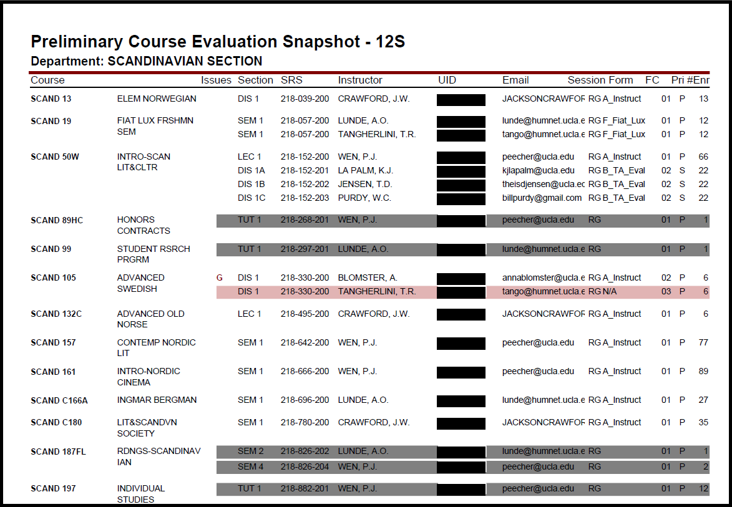
SAMPLE Snapshot

Slide 11
LEGEND – AT THE BOTTOM OF EACH SNAPSHOT

Slide 12
Departmental Evaluation Coordinators

Slide 13
Setting Up Data in Class Climate
SNAPSHOT DATA VERIFIED BY WEEK 7
PREPARING FOR EVALUATIONS IN WEEK 9
Course data is “Pushed” from MyUCLA into Class Climate Evaluation Software
USUALLY TAKES OVER 1 WEEK TO DO THIS

Slide 14
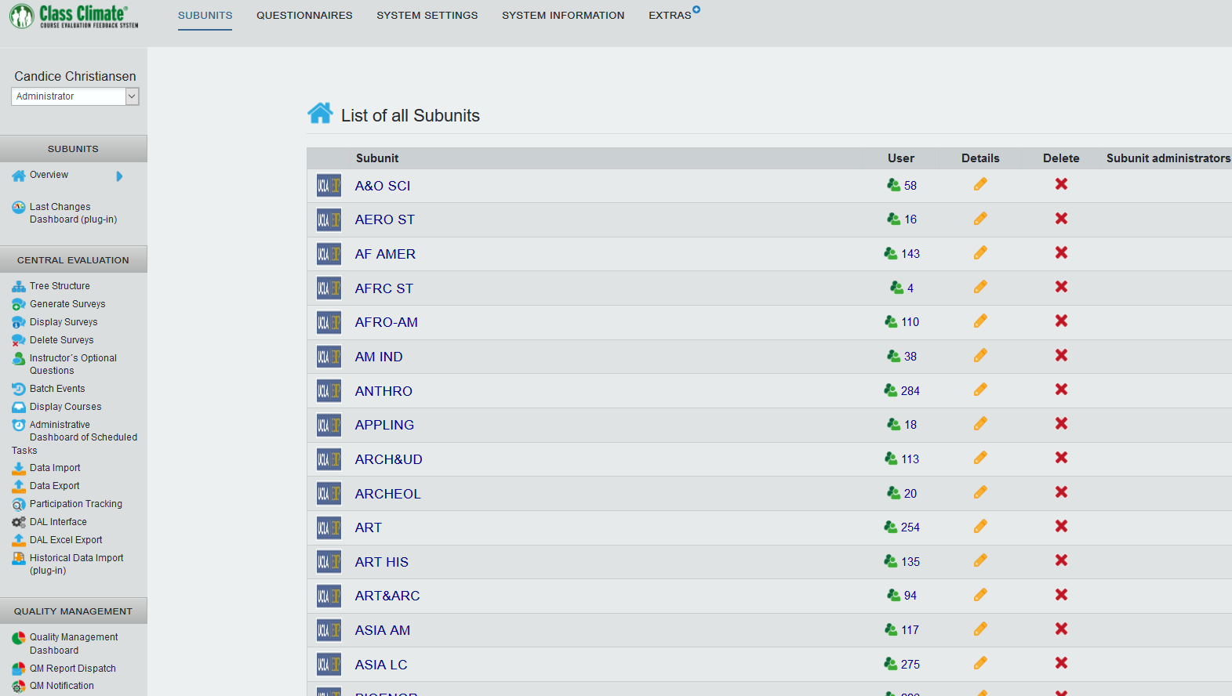
Class climate administrator view

Slide 15
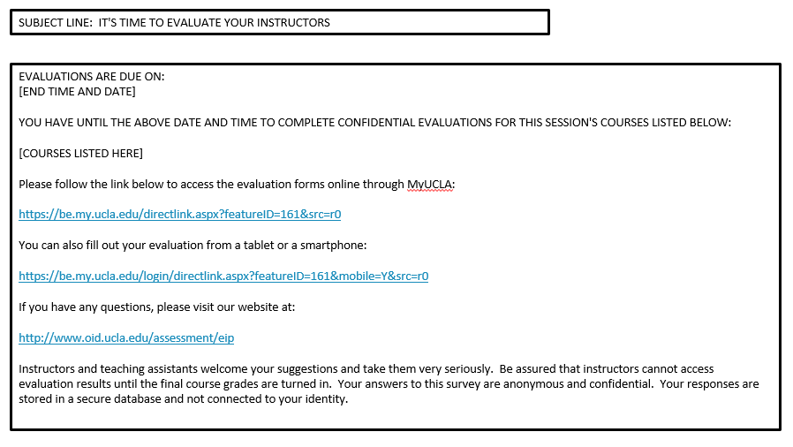
Courtesy email to students

Slide 16
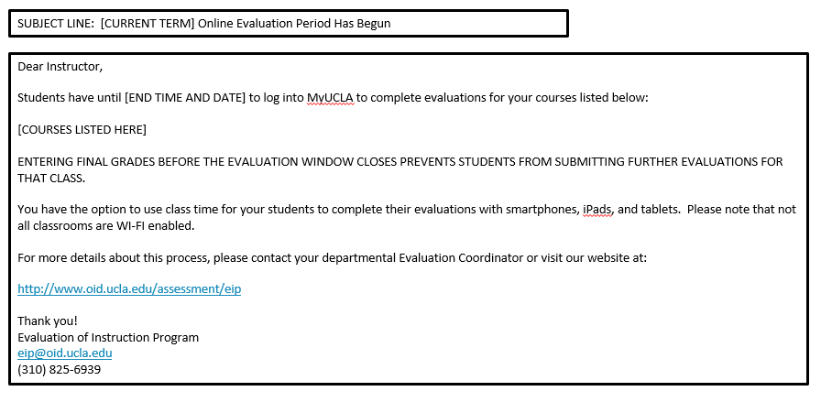
Courtesy email to Instructors

Slide 17
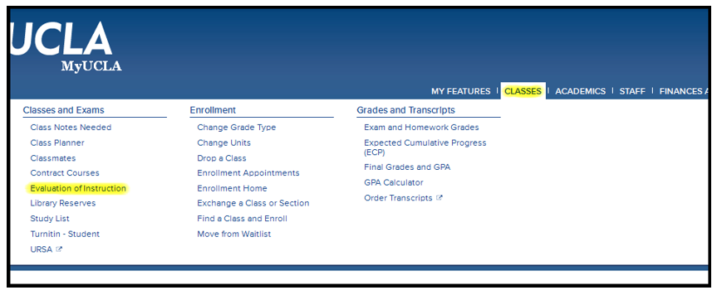
MyUCLA Student View
Students may access the evaluations page by simply logging into MyUCLA and clicking on the Classes menu and then Evaluation of Instruction

Slide 18
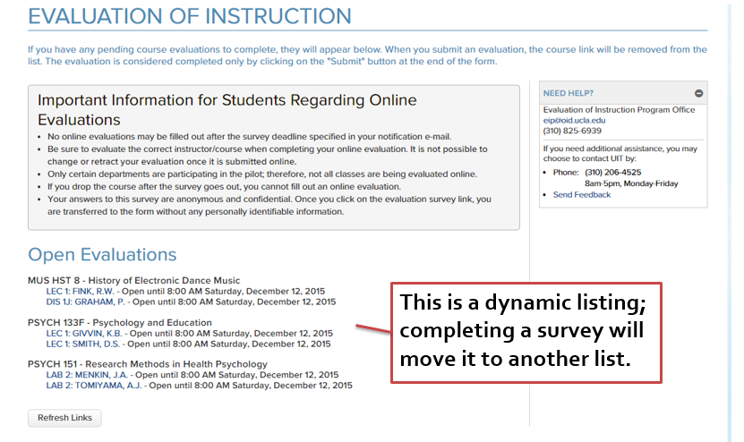
Evaluations on myucla - Active list

Slide 19
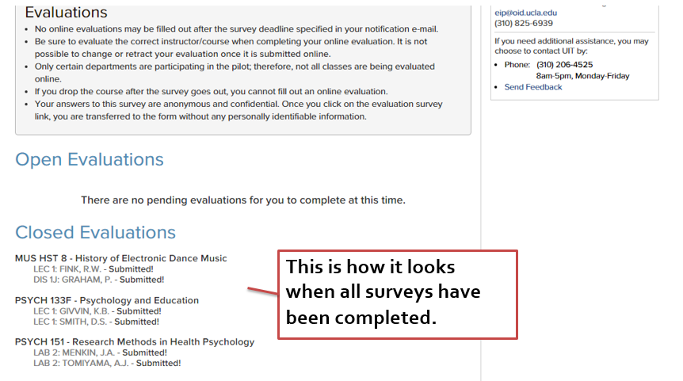
Evaluations on myucla - Active list

Slide 20
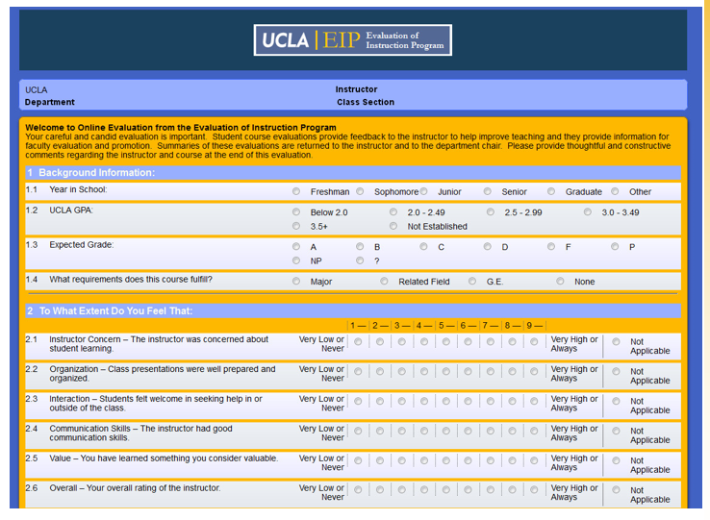
Online evaluation form example - Top

Slide 21
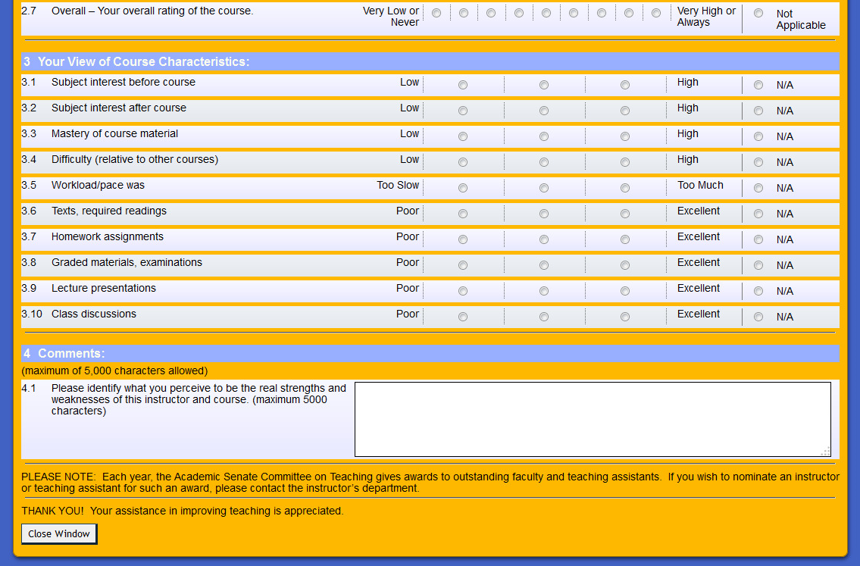
Online evaluation form example - bottom

Slide 22
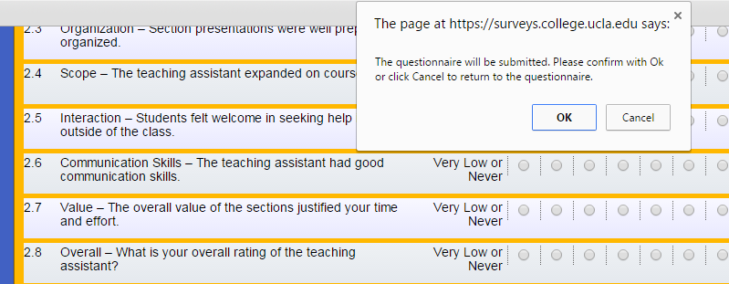
Online evaluation submission warning
-There is no “save and return” function
-Students must submit the survey or begin again when they are able

Slide 23
Reminding students
1 reminder email
1 “Last Chance” reminder email
If all surveys are completed, no further reminders are sent
SUBJECT LINE: LAST CHANCE: IT'S TIME TO EVALUATE YOUR INSTRUCTORS
EVALUATIONS ARE DUE ON:
[END TIME AND DATE]
YOU HAVE UNTIL THE ABOVE DATE AND TIME TO COMPLETE CONFIDENTIAL EVALUATIONS FOR THIS SESSION'S COURSES LISTED BELOW:
[COURSES LISTED HERE]
Please follow the link below to access the evaluation forms online through MyUCLA:
https://be.my.ucla.edu/directlink.aspx?featureID=161&src=r2
You can also fill out your evaluation from a tablet or a smartphone:
https://be.my.ucla.edu/login/directlink.aspx?featureID=161&mobile=Y&src=r2
If you have any questions, please visit our website at:
http://www.oid.ucla.edu/assessment/eip
Instructors and teaching assistants welcome your suggestions and take them very seriously. Be assured that instructors cannot access evaluation results until the final course grades are turned in. Your answers to this survey are anonymous and confidential. Your responses are stored in a secure database and not connected to your identity.

Slide 24
Reminding instructors
1 reminder email
1 Evaluations are Complete email
Once grades are submitted instructor may view their report
SUBJECT LINE: Online Evaluation – Accessing [CURRENT TERM] Reports
Dear Instructor,
Once final grades are submitted through Gradebook or Gradebook Express, log onto MyUCLA to view evaluation reports for your classes:
[COURSES LISTED HERE]
The following link will direct you to MyUCLA – Evaluation of Instruction Reports:
https://be.my.ucla.edu/directlink.aspx?featureID=163
ATTENTION MAC USERS: The program Preview does not support all of the report features. Please use Adobe Acrobat Reader to view these reports.
For more details about this process, please contact your departmental Evaluation Coordinator or visit our website at:
http://www.oid.ucla.edu/assessment/eip
Thank you!
Evaluation of Instruction Program
eip@oid.ucla.edu
(310) 825-6939
Please note: If final grades for a class are submitted after the Gradebook due date, the instructor and any associated TAs will need to obtain evaluation reports from the department’s Evaluation Coordinator.

Slide 25
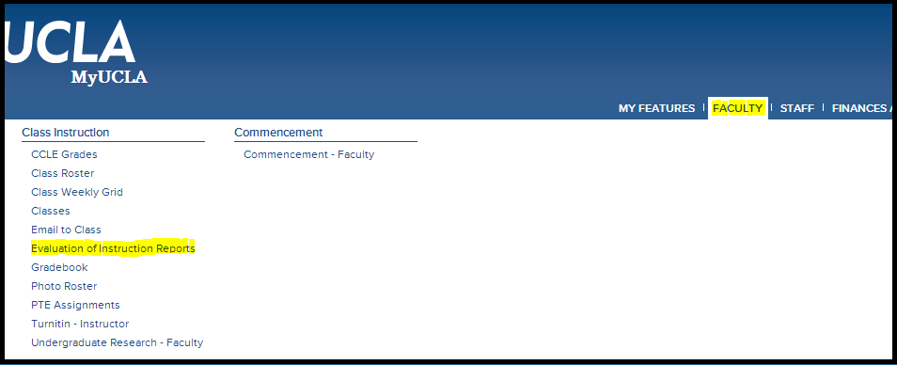
Myucla instructor view
Instructors may view the Evaluation of Instruction Reports by logging into MyUCLA and clicking on the Faculty menu then Evaluation of Instruction Reports.

Slide 26
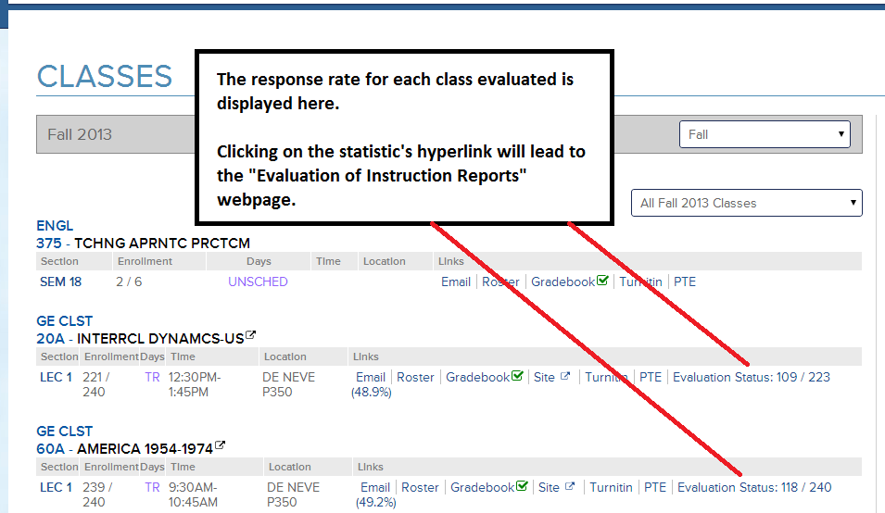
Myucla instructor view
While surveys are in progress:

Slide 27
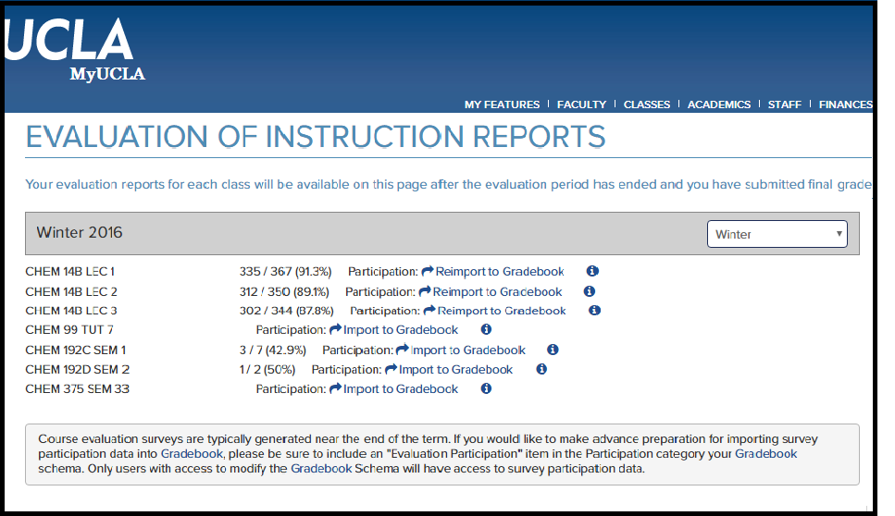
Myucla instructor view
When surveys are completed:

Slide 28
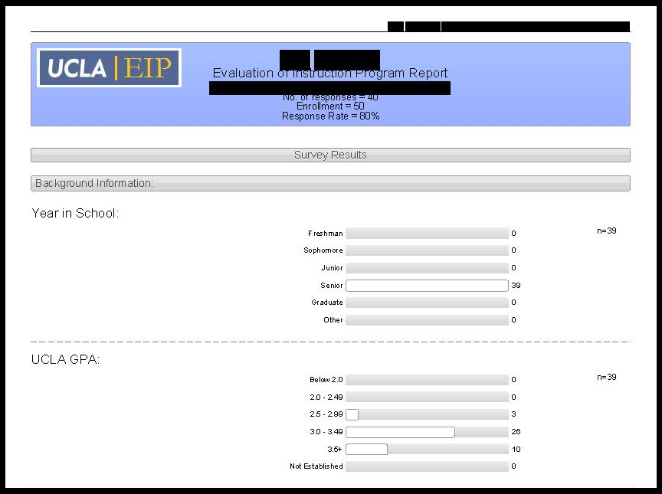
Instructor report example

Slide 29
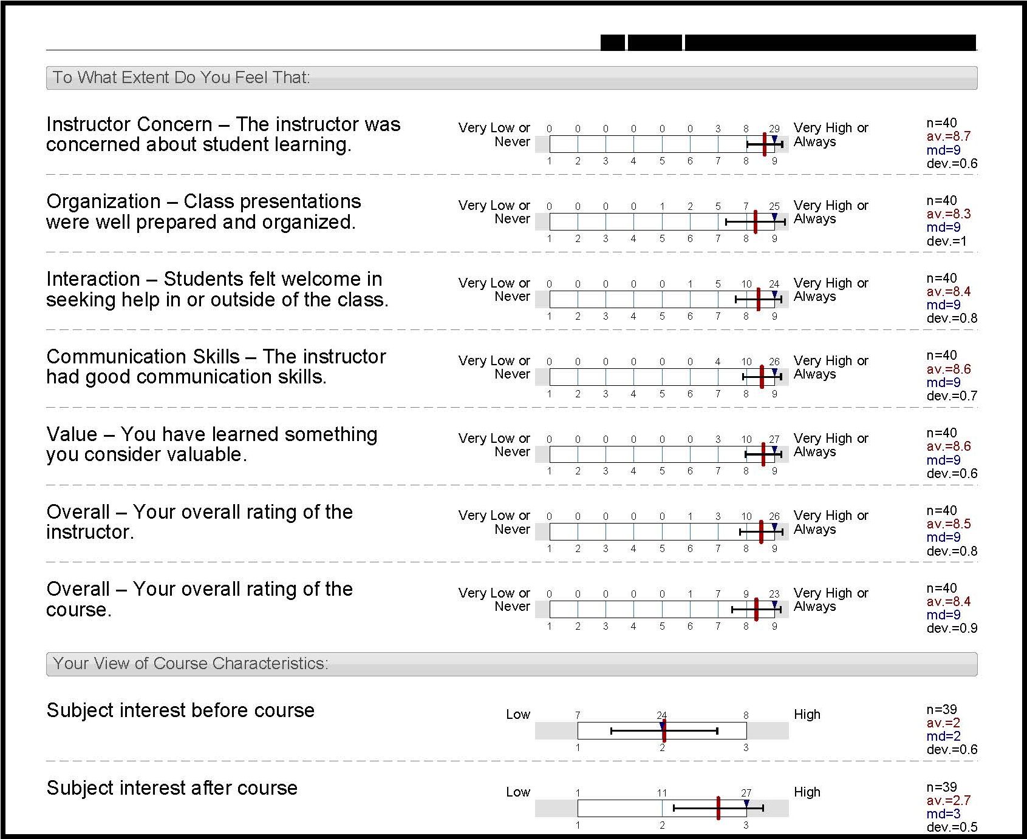
Instructor report example

Slide 30
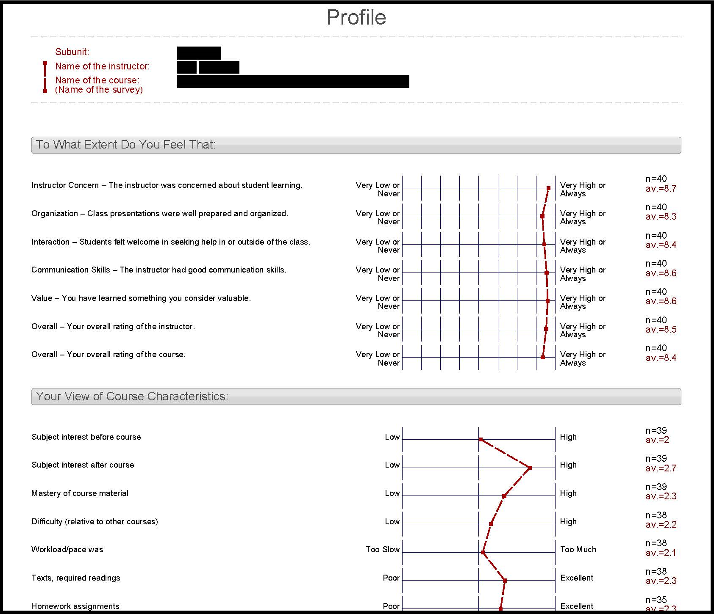
Instructor report example

Slide 31
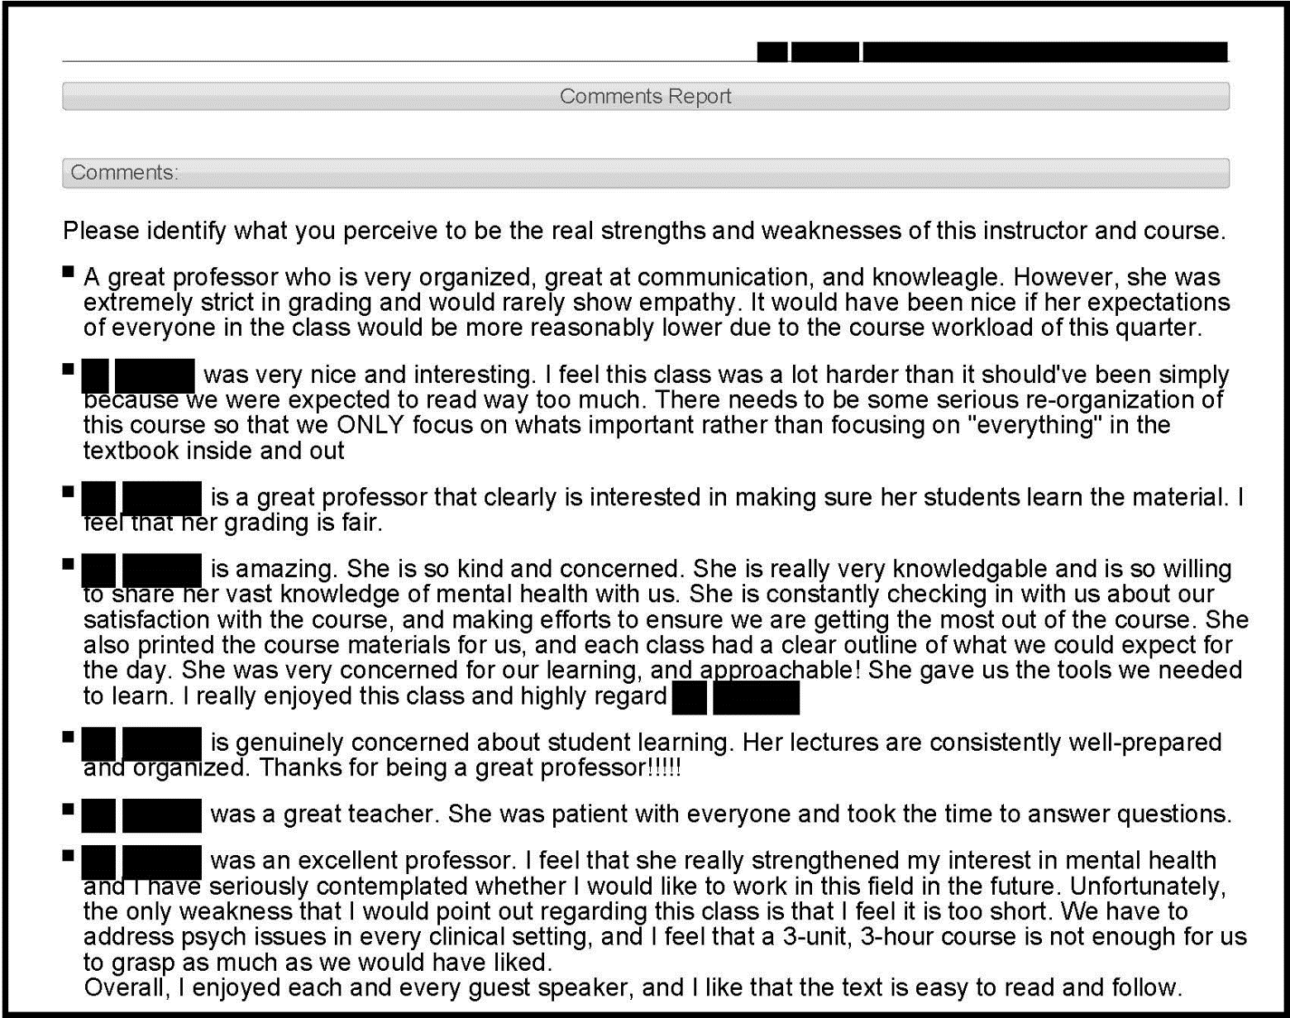
Instructor report example

Slide 32
Instructor report example

Slide 33
Data belongs to Departments
Distributed quarterly on Box.com after it is processed
Our office shares access of Department’s Evaluation Data with Evaluation Coordinators
Cross Listed Courses -Evaluation Coordinators must communicate to share data

Slide 34
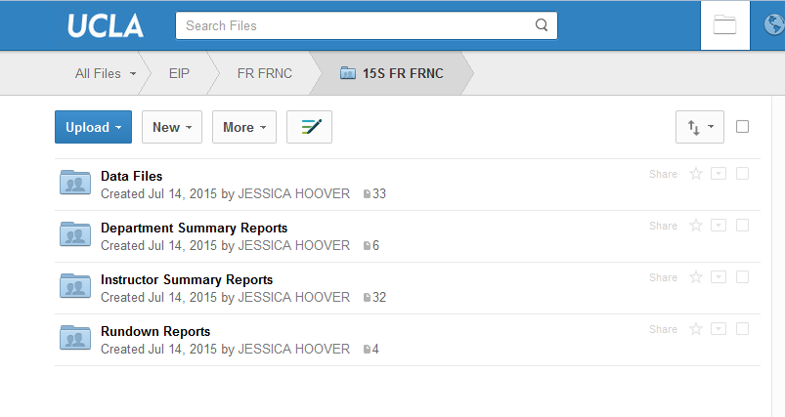
Giving Data to Departments – box.com

Slide 35
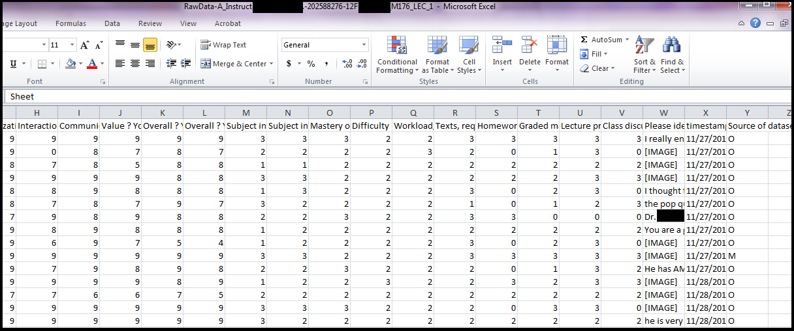
1) Data files – raw data collected

Slide 36
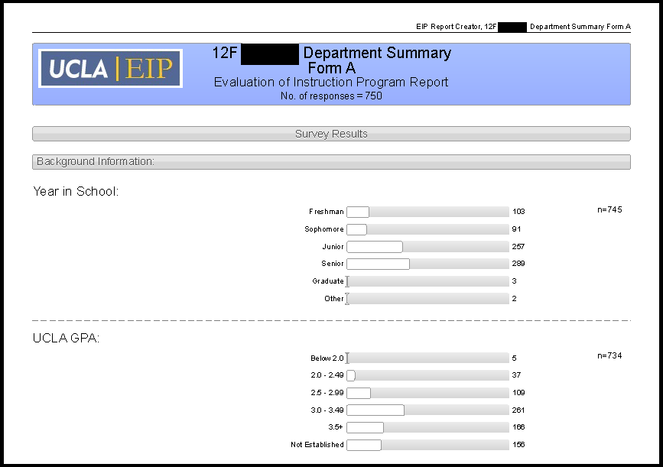
2) Department summaries – by form

Slide 37
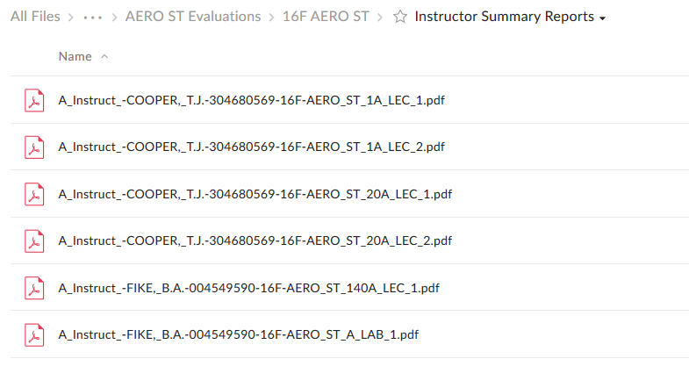
3) Instructor summaries – All

Slide 38
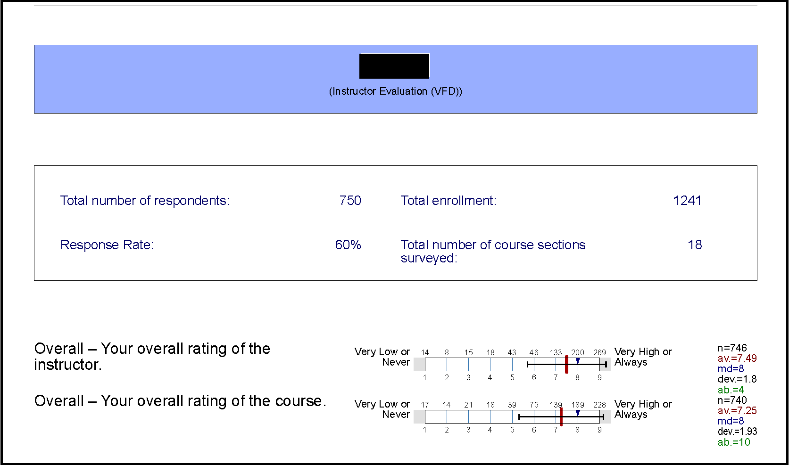
4) Rundown reports – by course/by instructor

Slide 39
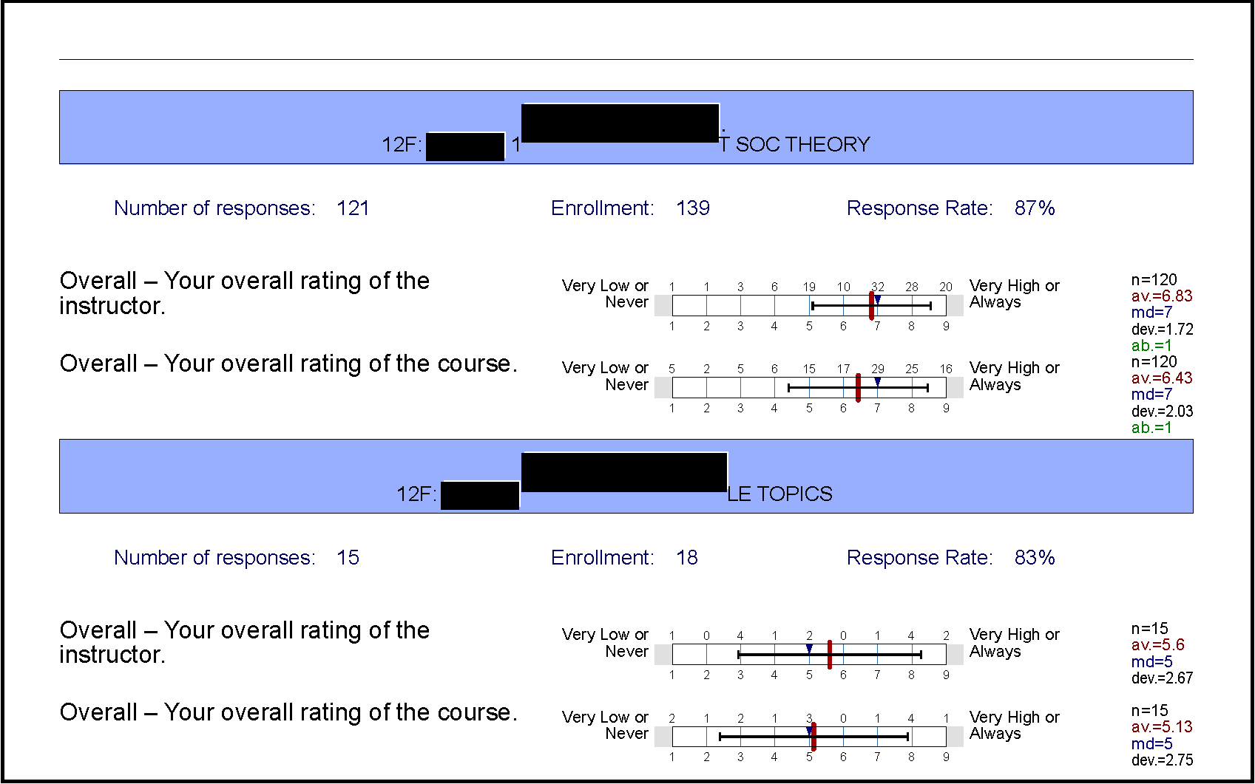
4) Rundown reports – by course/by instructor

Slide 40
Summer courses at ucla
Session A – 6 Weeks
Session A – 8 Weeks
Session A – 9 Weeks
Session A – 10 Weeks
Session C – 6 Weeks
5 mini evaluation periods within Summer Sessions

Slide 41
Summer courses at ucla
Registration Codes Indicate When in Summer the Evaluations will occur

Slide 42
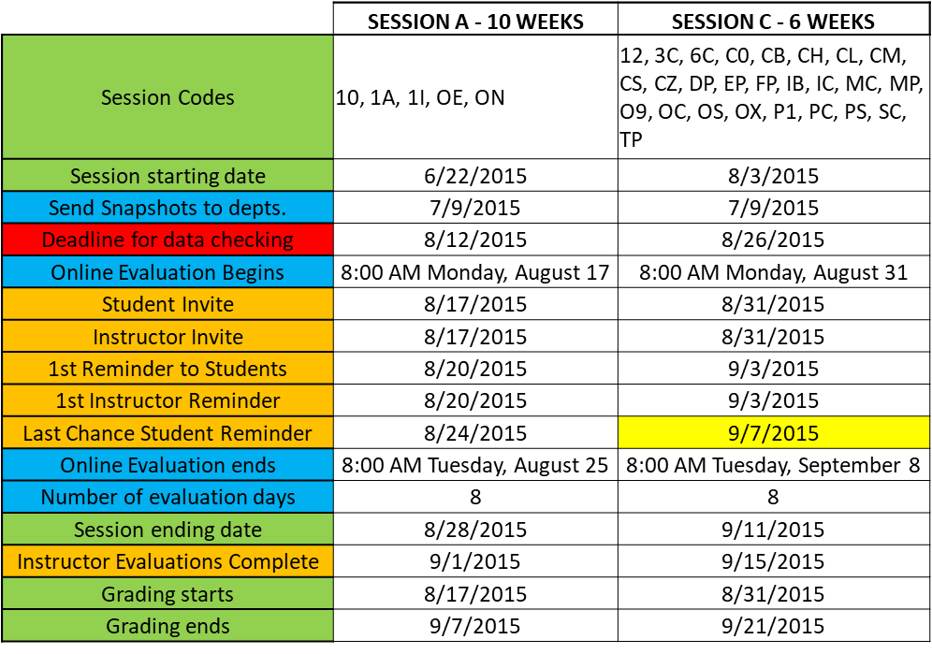
Summer Schedule for Evaluation coordinators
Registration Codes Indicate When in Summer the Evaluations will occur

Slide 43
The future of evaluations
Topics Under Consideration:
-Report formatting
-Research of other universities
-Custom evaluation questions
-Sharing data
-Options for students
-Issues about editing comments
-Mid-quarter assessments
-Student focus group research
-Use of Data within departments

Slide 44
Thank you!!
Please ask questions, and share this information with your department or program.
Thank you for being part of this process!

